Slide 1

CE 40-443 Computer Networks Introduction To Mininet
Arshiya Rezaie
Spring 1400
https://github.com/arshiarezaei/course-net
Notes:
Slides adapted from similar courses at Princeton, Stanford, UC Berkeley, University of Michigan, etc.

Slide 2
Agenda
Experiential Learning for Networking
Platforms for Network/Systems Teaching (and Research)
What is Mininet
TRADITIONAL SWITCH ARCHITECTURE
Mininet topologies

Slide 3
Acknowledgment
This presentation is influenced by the following university materials from similar courses
John Hopkins University, USA.
University of New South Wales, Australia.
University of North Carolina at Chapel Hill, USA.

Slide 4
Experiential Learning for Networking
"Learning by doing" is memorable and leads to mastery.
In computer systems courses, this means building, modifying, using, and experimenting with working systems.
Networking (and distributed systems) courses require complicated testbeds including multiple servers and switches.

Slide 5
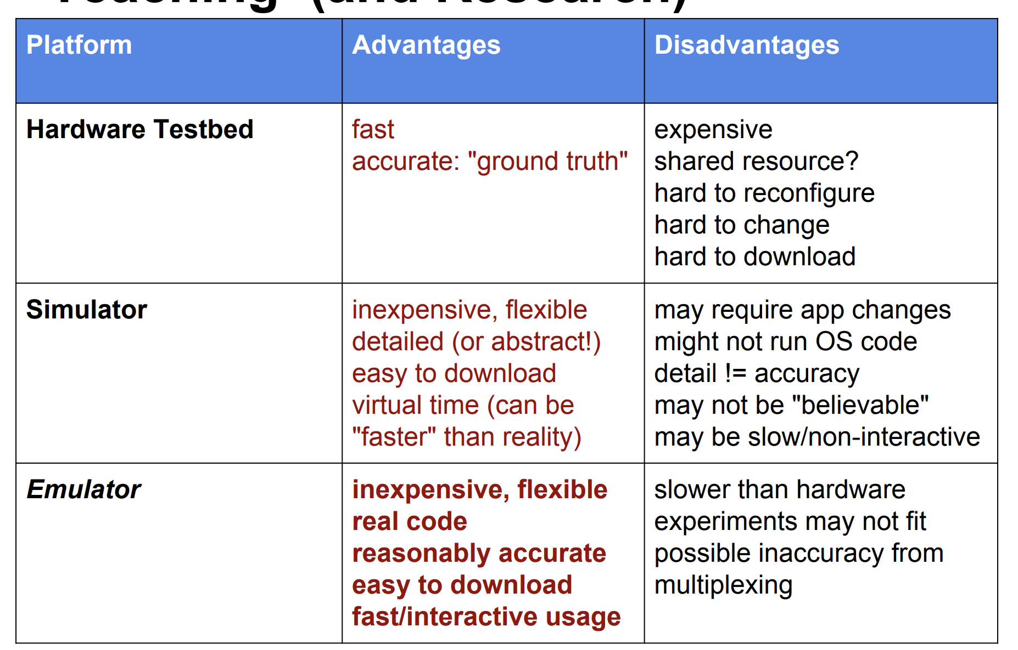
Platforms for Network/Systems Teaching (and Research)

Slide 6
What is Mininet
Mininet is a software that emulates virtual network environment with OpenFlow support.
Network Emulators can facilitate teaching networking via realistic live demos, interactive labs and course assignments
inexpensive, interactive, real apps and OS, reasonably accurate - downloadable, fast setup
Mininet is a lightweight virtualization/container based emulator
modest hardware requirements, fast startup, hundreds of nodes
command line tool, CLI, simple Python API
SDN as well as Ethernet/IP networking as well as SDN
Install using VM, Ubuntu package, or source
Mininet is popular in research community.

Slide 7
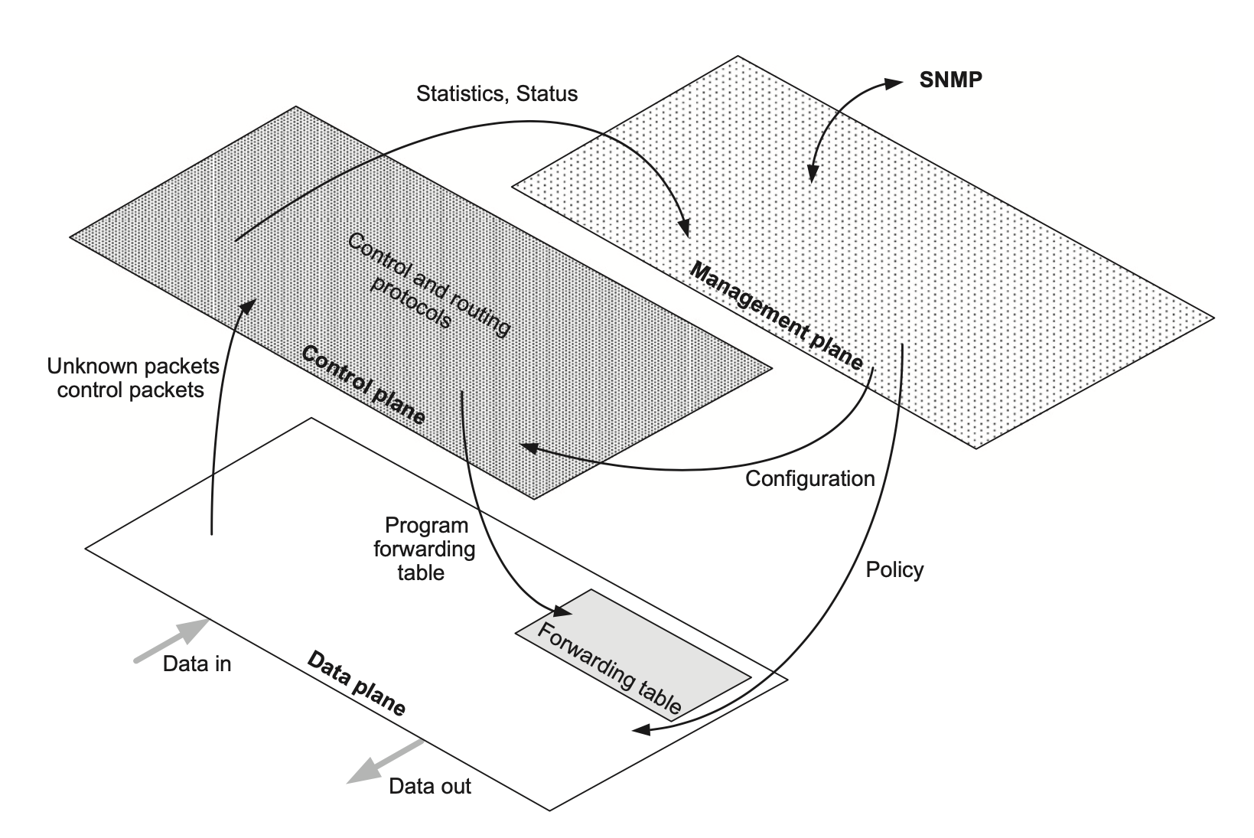
TRADITIONAL SWITCH ARCHITECTURE

Slide 8
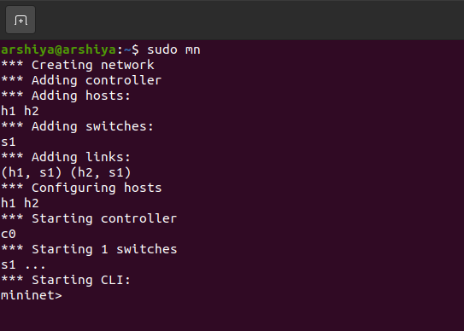
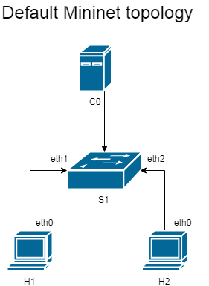
Let’s code

Slide 9
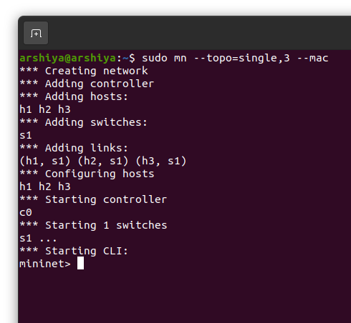
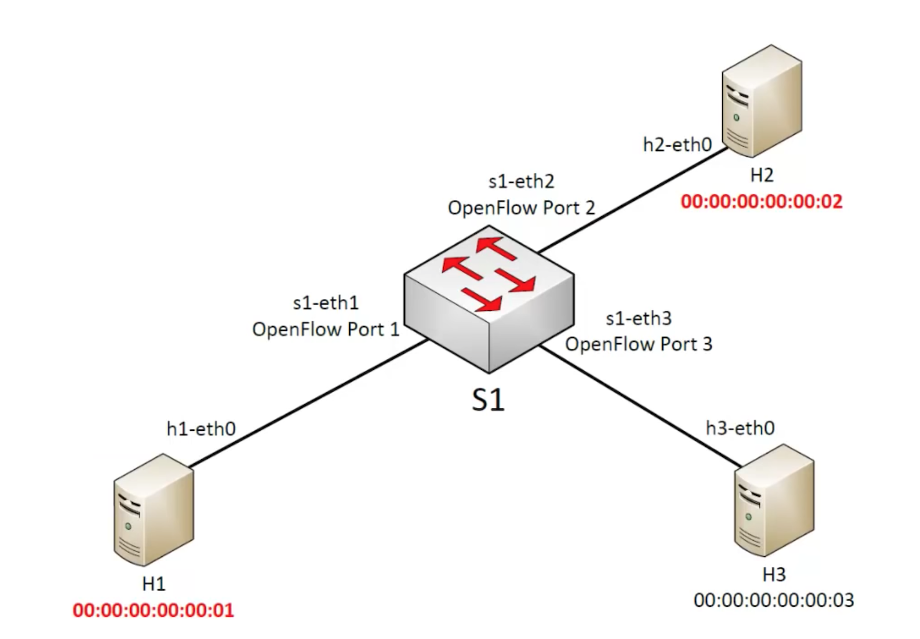
Single Topology

Slide 10
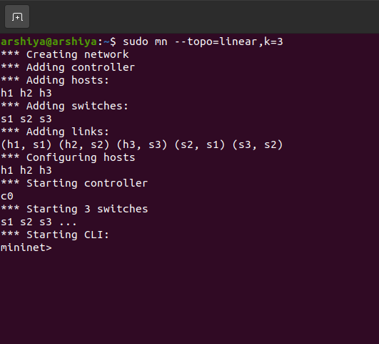
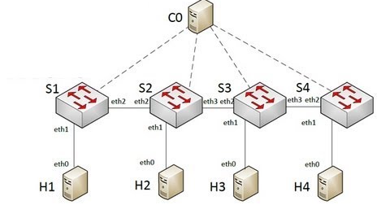
Linear Topology

Slide 11
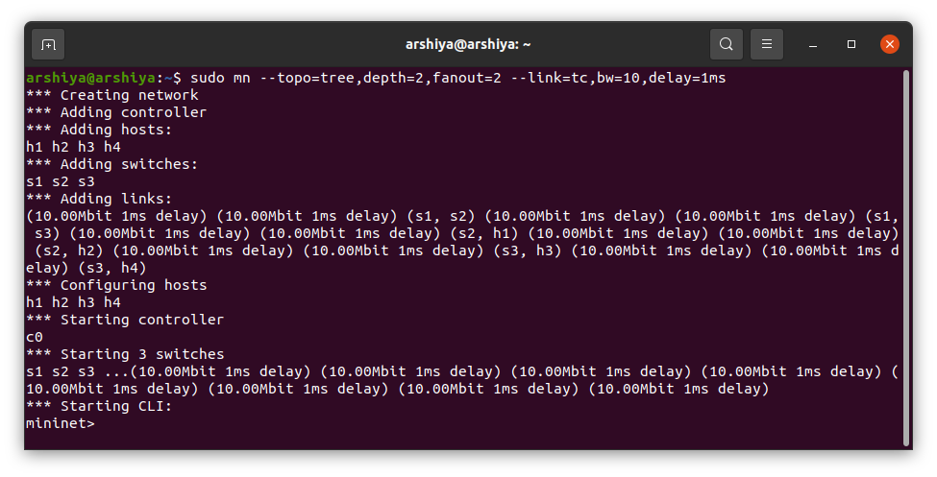
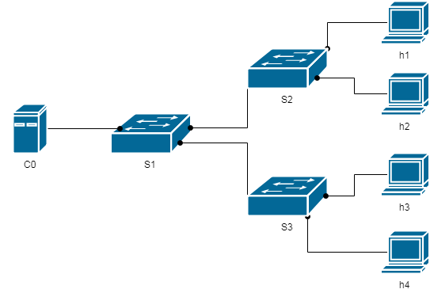
Tree Topology

Slide 12
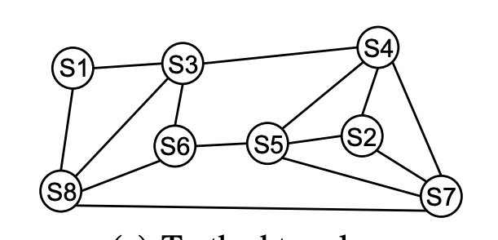
Custom Topology

Slide 13
Useful Resources
SDN-LAB
Introduction to Mininet
Mininet Visualizer
SIGCOMM-2014

Slide 14


